Slide 1
Assessing the Preservation of DPX Image Sequences
within
MoMA’s Digital Preservation Ecosystem

Slide 2
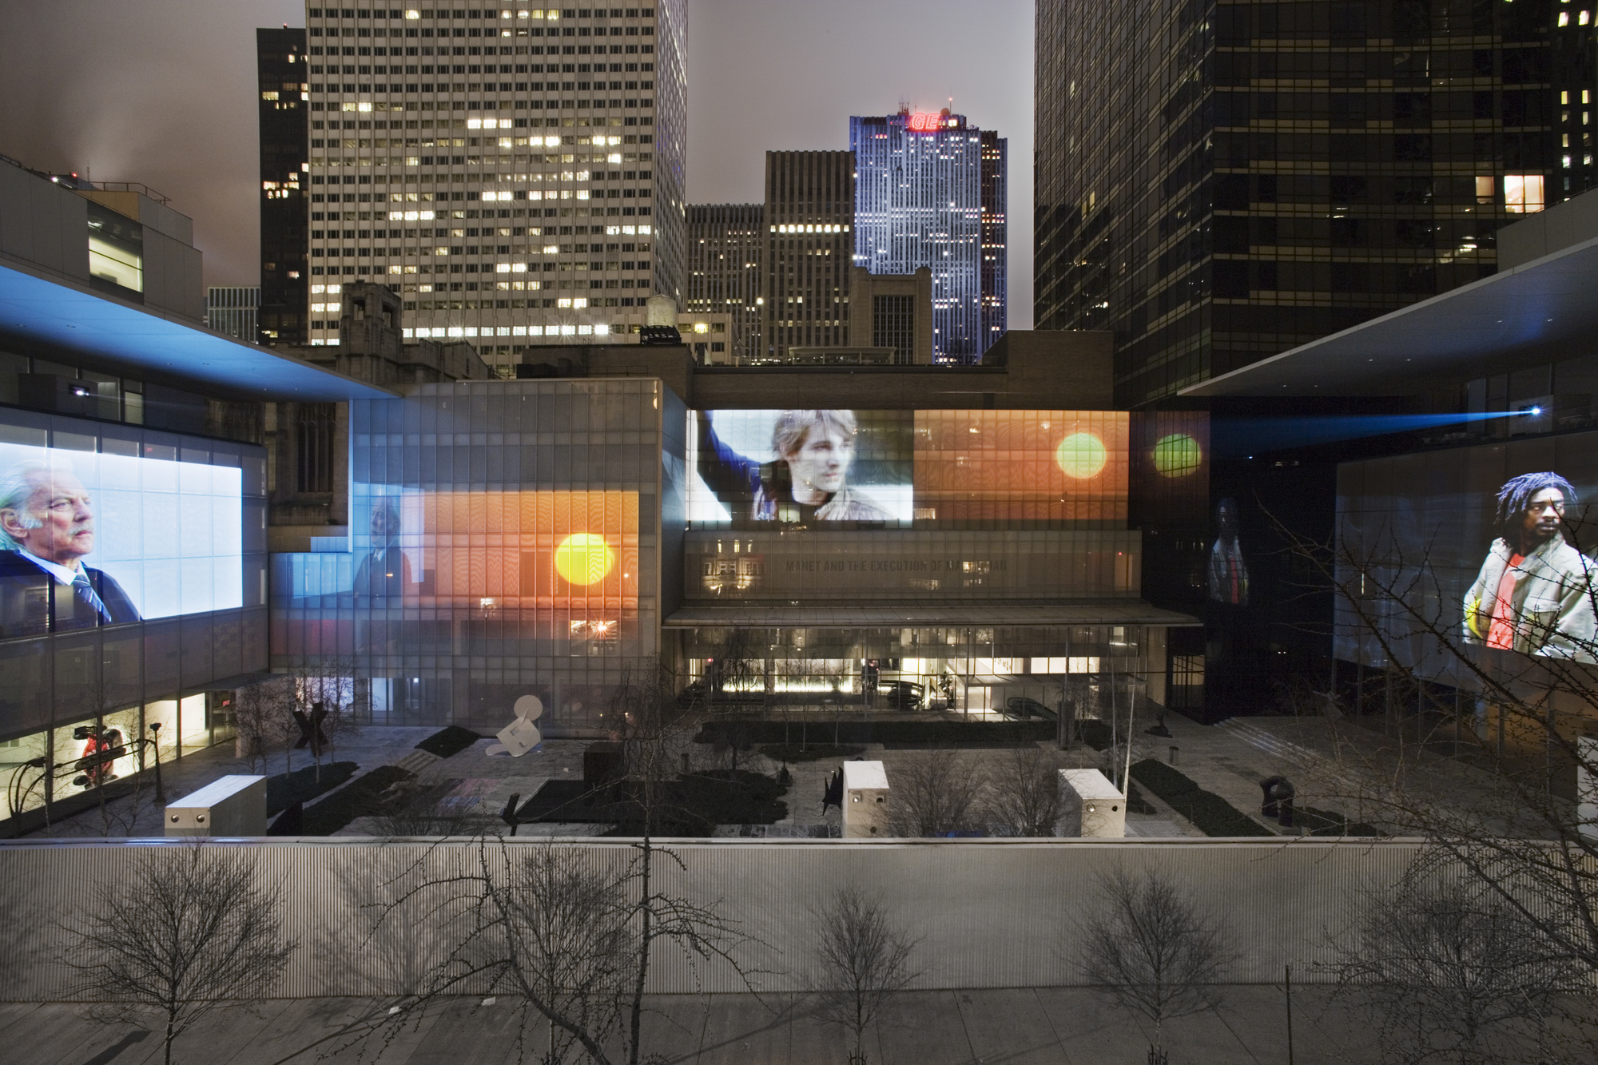
Doug Aitken. sleepwalkers. 2007. Six-channel video (color, sound)

Slide 3
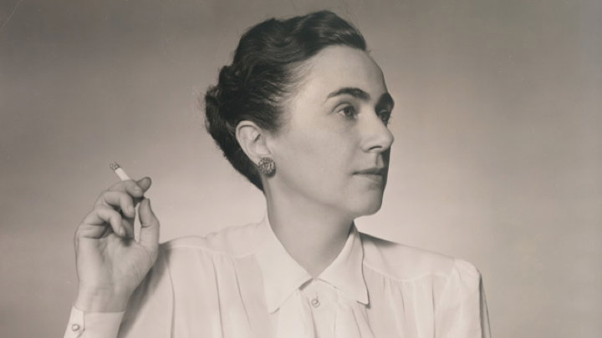

Slide 4
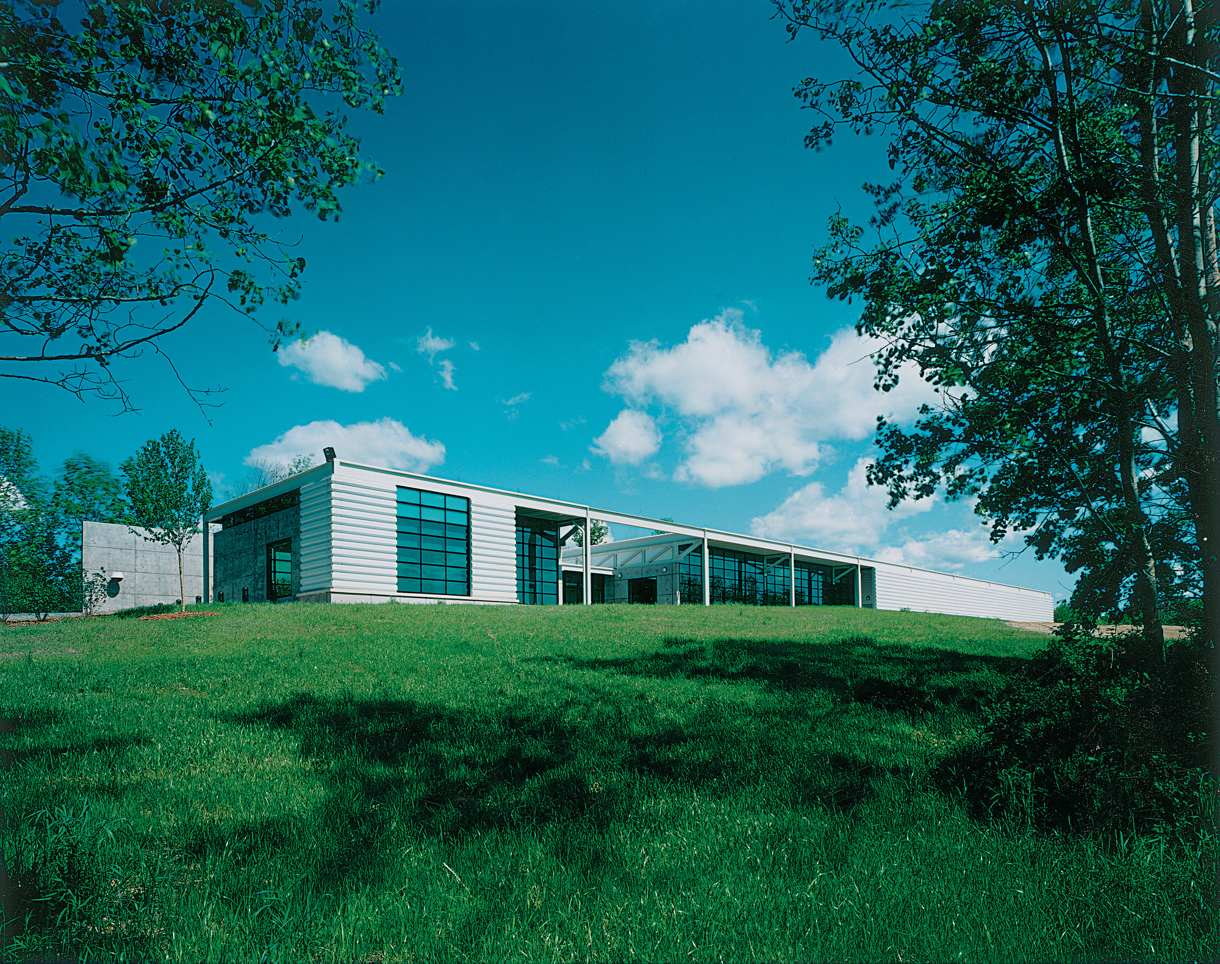

Slide 5
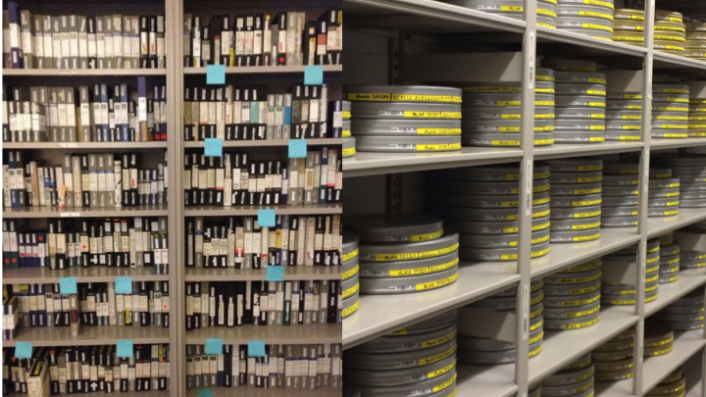
Notes:
Founded in 1935 as the Film Library, this department’s collection now includes more than 30,000 films and 1.5 million film stills; the strongest international film collection in the United States, it incorporates all periods and genres. Among the holdings are original negatives of the Biograph and Edison companies, and the world’s largest collection of D. W. Griffith films. The film collection is stored in the Museum’s Celeste Bartos Film Preservation Center, a state-of-the-art facility that opened in June 1996.

Slide 6
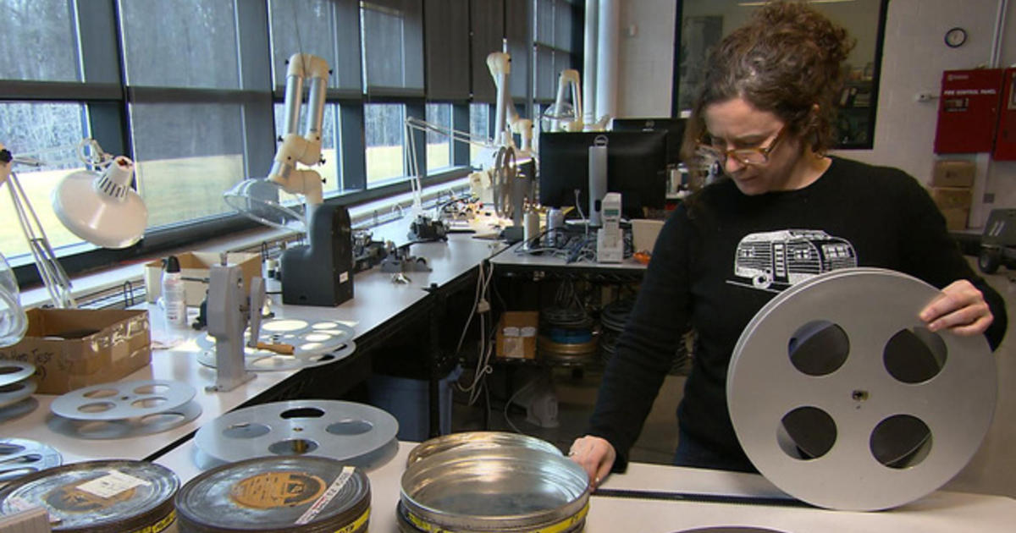

Slide 7
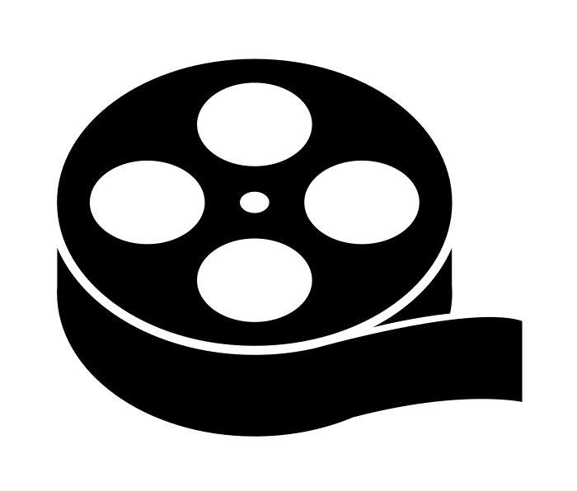
Film by Joe Mortell from the Noun Project

Slide 8
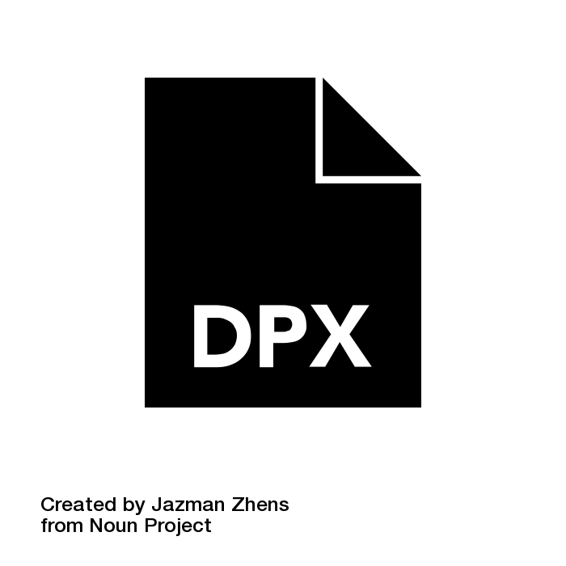
File Format Glyph by Jazman Zhens from the Noun Project

Slide 9

Hard Drive by Ben Davis from the Noun Project

Slide 10
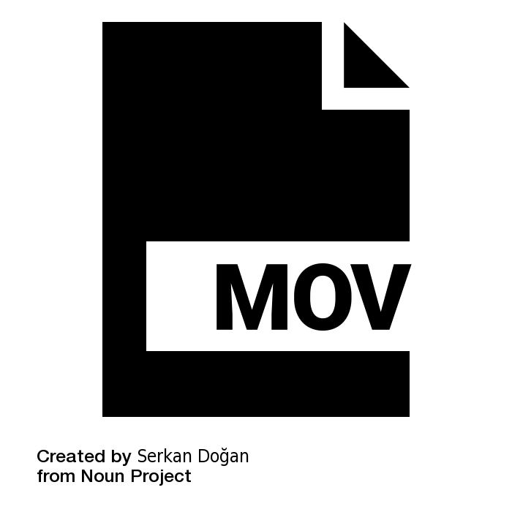
mov by Serkan Doğan from the Noun Project

Slide 11
Digital Repository for Museum Collections
(DRMC)

Slide 12
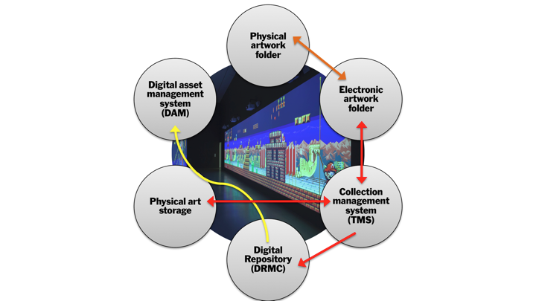

Slide 13
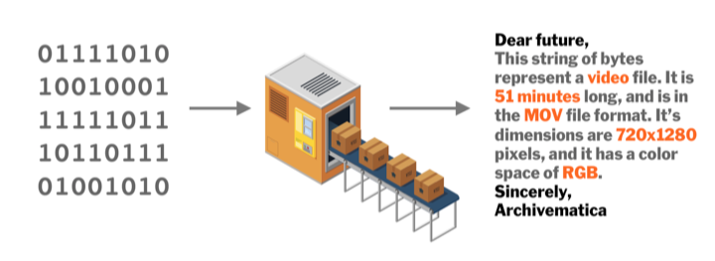

Slide 14
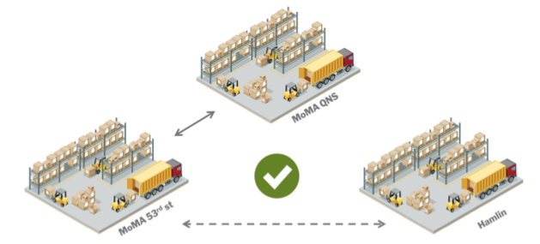

Slide 15
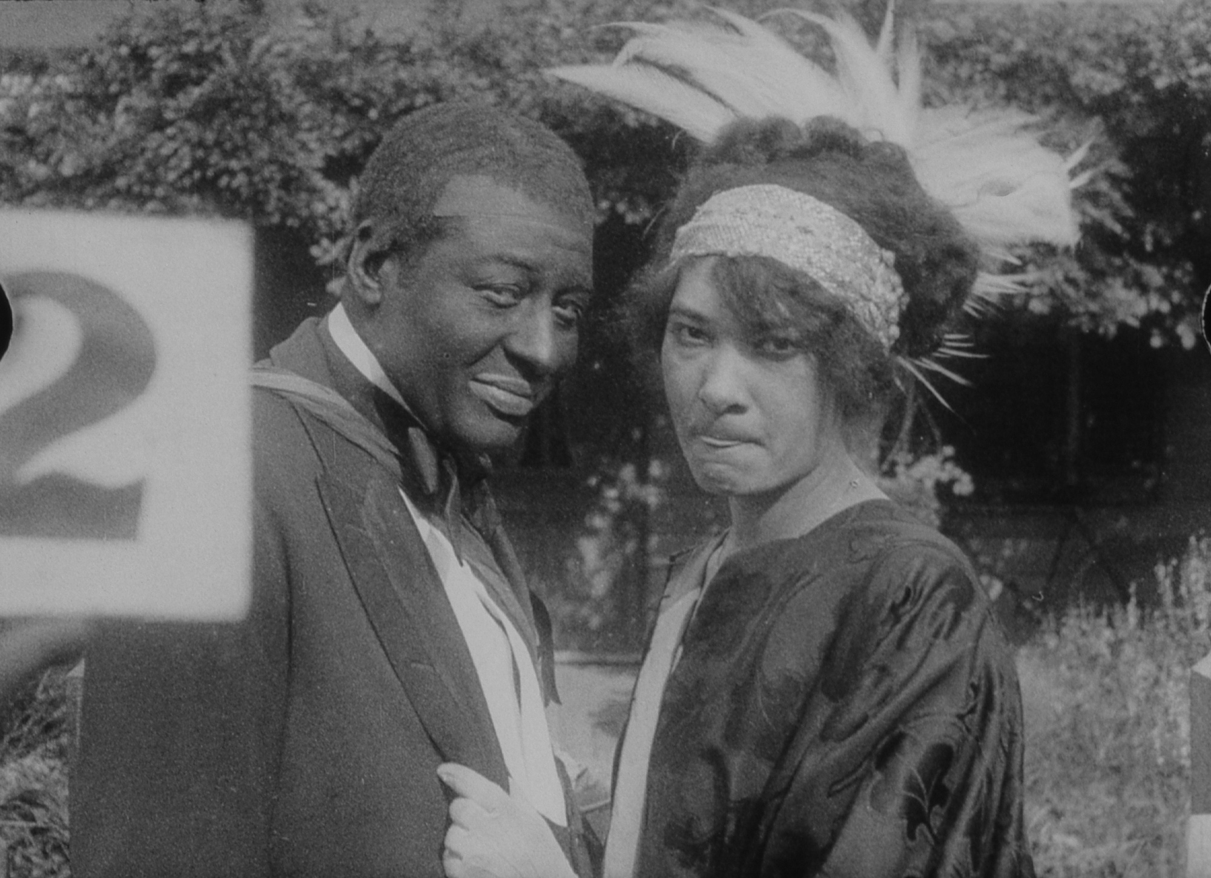
Lime Kiln Club Field Day 1913/2014

Slide 16
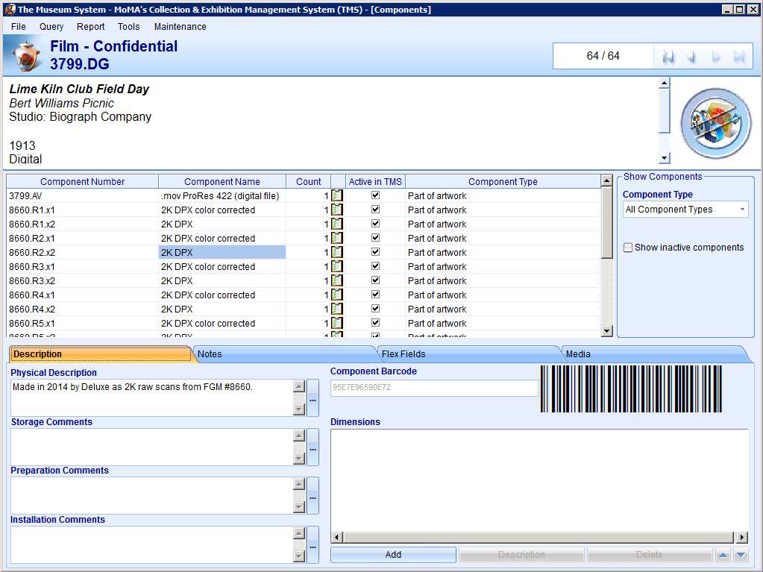

Slide 17
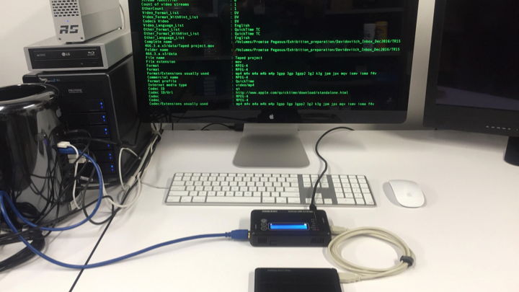

Slide 18
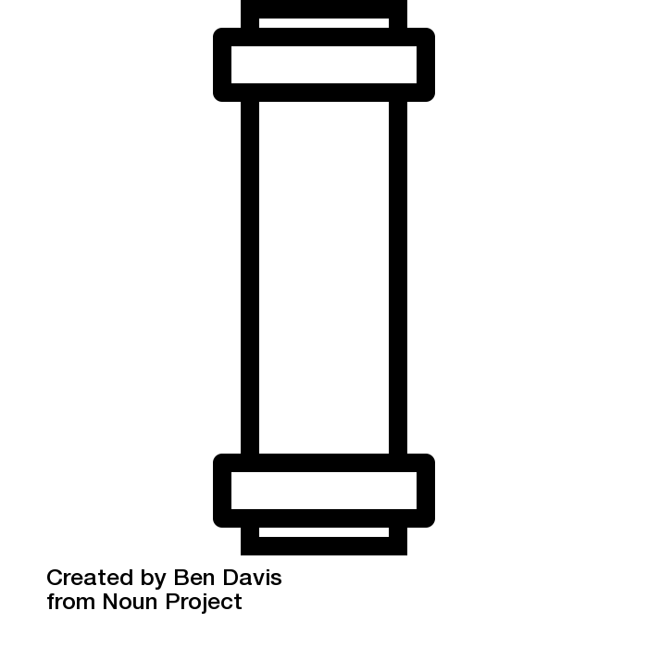
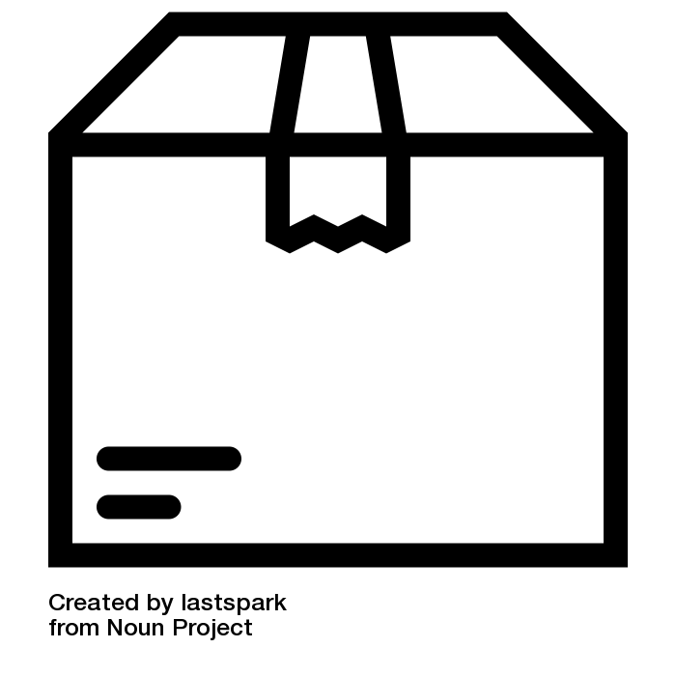
AIP
Package by lastspark from the Noun Project
Straight Pipe by Ben Davis from the Noun Project

Slide 19

AIP
Jammed Pipe by Ben Davis from the Noun Project

Slide 21
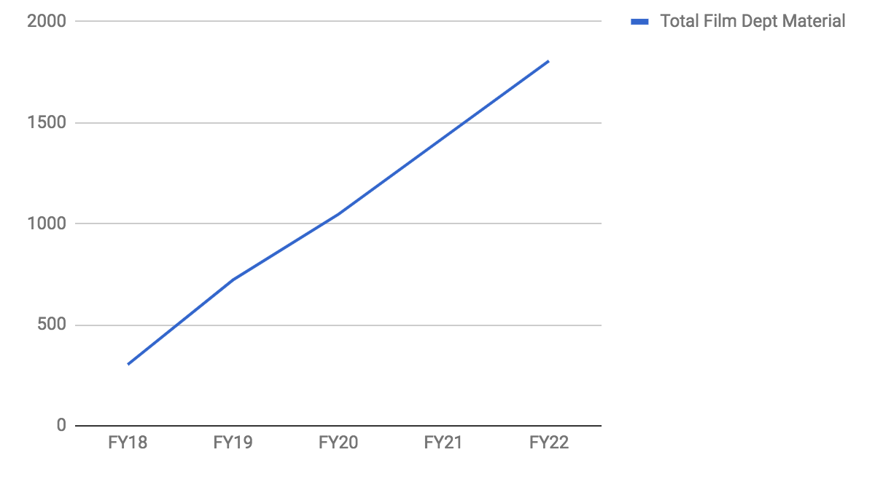
In TBs

Slide 22
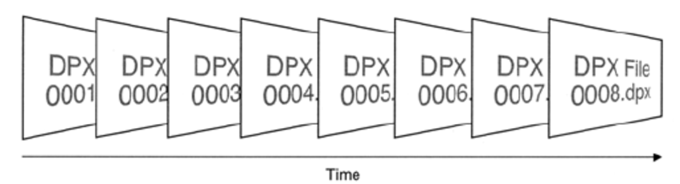
The challenges of DPX
Massive quantity of DPX files coming into MoMA’s collection
Complexity of DPX in terms of ingest
Ingest workflow was designed around single file ingest, not complex multi-file sequences
How to capture the preservation decision making process
Adapting our ever-evolving condition assessment and documentation workflows to multi-file sequences
Bridging knowledge gaps between vendors and conservation department
Notes:
It’s clear that at MoMA, we are struggling with the difficulty of managing a massive quantity of DPX files that are coming into the collection. Similarly, we are faced with the challenges of capturing the key decision making processes of film preservation projects undertaken by MoMA’s film department.
The key decisions we would want to capture would include metadata about the person or persons involved in a particular preservation project, an ownership statement, creation date, fixity, metadata about the original film element (gauge, color system, audio, generation, etc). This research and developing a capacity for embedding metadata into our film preservation file deliverables would in turn help us (since we are working on two separate departments within a large cultural institution) bridge a knowledge gap with vendors and film/conservation departments.
An additional impetus for diving head on into this research was that we wanted to develop a workflow and methodology for condition assessing and documenting DPX sequences coming out of film preservation projects.
Our traditional ingest workflow was designed around single file intake, thus to handle the massive quantity of files in a strategy to disk image drives containing multiple DPX projects was devised.

Slide 23
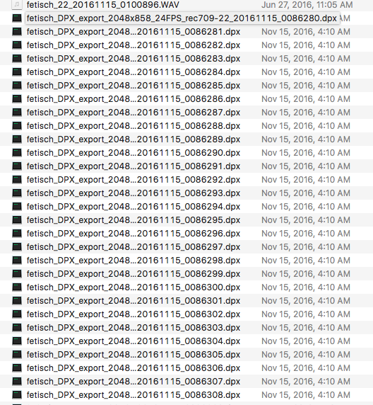
The challenges of DPX
Lack of consensus amongst the field in terms of the handling and/or preservation of DPX materials
File format sustainability unknowns
Curation of material (what to keep and why?)
Notes:
We also saw/thought that there is a lack of consensus (hence the name of this conference) amongst the field in terms of handling and/or preservation of DPX materials.The unknowns of DPX sustainability as a file format (though widely used, perhaps not as self descriptive as other formats) added another blind spot which propelled our research.
A crucial aspect, considering our collection’s size, was determining what to keep and why? Since a single film preservation project is likely to produce a variety of deliverables in multiple file types with diverse classifications associated to them.
We found ourselves asking; should we keep RAW un-color corrected scans for future use?
What can we do without and how can we trim our storage usage?

Slide 24
Research into the DPX format
Researching and examining the DPX file format.
What it is?
How is it supposed to be rendered or played back?
Characterization methods, metadata extraction, embedding metadata, tools
How others are working or managing large quantities of DPX files
Notes:
Before tackling all of our hopes and dreams, we needed to delve into big wide open of the DPX format.
We wanted to know How it is supposed to be rendered and played back?
What characterization methods exists, which metadata extraction tools peers are using and how others are working with large quantities of DPX files.
So, we know that DPX (Digital Picture Exchange) is a SMPTE standard, for a “pixel based raster file format intended for very high quality moving image content with attributes defined in a binary file header.” The DPX file format was derived from the Kodak Cineon to “support the transfer of uncompressed images between telecine machines”, currently there are two versions of DPX files v1 and v2, the content differences between DPX v.1 (SMPTE 268M-1994) and DPX v.2 (SMPTE 268M-2003) specifications are, in summary, updating references to other SMPTE standards and assigning previously reserved file space for specific purposes.
Each DPX file represents a single image or frame in a sequence of a motion picture or video data stream. As a structured raster image format, DPX is intended to carry only picture or imagery data, with corresponding sound carried in a separate format, typically the WAVE format.
• Adoption by larger organizations in the international archival community, including the US National Archives, UCLA Library and Library and Archives Canada. • Wide range of motion picture film scanners support output to DPX.
CON
• DPX files do not playback in the traditional sense, as each frame of film in a reel is captured to an individual DPX file. Applications must support the playback of file sequences to mount and display DPX files. • File storage bandwidth requirements are extremely high for the realtime playback of uncompressed, high resolution DPX sequences. Long term storage capacity requirements are also challenging due to the large sequence sizes eclipsing 4TB per hour at 4K resolutions.

Slide 25
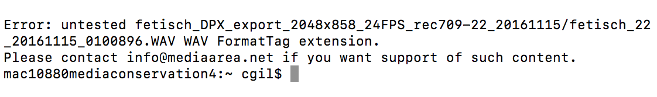
What we are doing and how we are doing it
Establishment and Refinement of Internal Procedures and Workflows (within and across depts) to capture and assess material in an efficient and responsible manner
Trying to understand the significant properties of DPX
Strategies to document process history and decision making in the DPX file format itself
Notes:
The reason we wanted to do this was because we wanted to re-establish and refine our internal procedures and workflows within and across departments (film/cons) in order to capture, assess and ingest material in an efficient, responsible manner. We also want to understand the significant properties of DPX as it relates to media conservation and develop strategies to document the process history and decision making, ideally, within the files themselves or alternatively as a sidecar file.

Slide 26
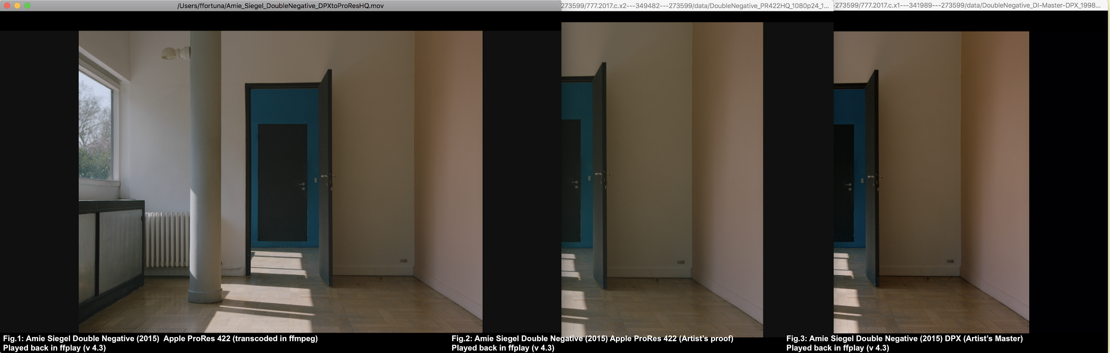
Metadata
Reviewing FADGI guidelines
Analysis of Tools
MediaInfo
Exiftool
Imagemagick
DPX Analytics
GraphicsMagick
Analysis of Terminology
how fields are translated
From one tool to the next
Notes:
So, how did we do this?
My lovely fellow fellow colleague, Flaminia Fortunato and I compiled a list of metadata readers and analysis tools that we wanted to play with; Mediainfo, exiftool, imagemagick, dpx analytics, etc and dumped the output of these tools onto a spreadsheet for comparison. We reviewed the FAGDI guidelines, specially the strongly recommended fields section.
We used a small sample of files in 2k resolution 10-bit files coming in from 8mm, & 16mm, film sources in color and black and white.
We then looked at how the tools were expressing metadata values, in some instances, terminology would change from one tool to the next.
So far, we have not yet encountered a lot of differing values from the tools we looked into. We found that MediaInfo’s trace report was satisfactory, due to some sponsored development work which allowed MediaInfo to read, parse and output DPX metadata into an XML file. In our archivematica workflow, this xml file would be ported into a METS XML file that would live with the work’s AIP.
Even though DPX is a ‘standard’ it is not one which is properly adhered to. The file header is able to record a large amount of information about each DPX file, but much of this is either not used properly by the application writing the DPX file, or not used at all.
From our reading and research, we found that the file header field which records the color space of the DPX (log, linear, CCIR 709 etc) 3 is frequently incorrect, which can mean that systems which rely on this information for display or transcoding may have problems (see next point).

Slide 27
Playback, transcoding, and packaging tools
Playback
ffplay
DaVinci Resolve
Adobe Premiere
Looking into lossless transcoding options for efficient storage and preservation
MXF/OP1a
MXF/JPEG2000
FFV1/MKV
Lossless compression/packaging tools
ZIP
TAR
Notes:
This eventually led to us researching playback software for DPX for our condition assessment procedures (ffplay, resolve, premiere) and lossless transcoding options that are out there
for efficient storage and preservation, including; MXF/OP1A, MXF/JPG2K,FFV1/MKV and examining packaging options such as zipping and tarring directories.
In this testing phase we took note of the time it took to process files in their transcoding/transformation and within our archivematica pipeline, we additionally ran tests to addition to mux our DPX and WAV test files using RAWcooked. We took the newly created OP1a, JPG2K and MKV files and transcoded them back into DPX and verified checksums as a control method for corroborating if any file corruption had occurred.
Transformations done with Davinci Resolve
MXF OP1A
DaVinci Resolve gives you the option of selecting between the DNxHR, Avid 1:1, DNxHD, Kakadu JPEG 2000, Sony MPEG4, XDCAM MPEG2
FFV1/MKV
Transformation done with RAWcooked
From DPX to MKV and back with no md5 checksum changes (on the first file of the directory)
When transforming a file back to what it was, the tool RAWcooked produces a sidecar file called reversibility data. It is a EBML file

Slide 28
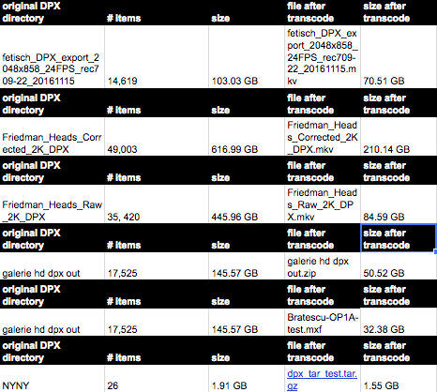
Preliminary results
2K resolution DPX directory composed of 14,619 files amounted to 103.03 GB transformed into a 70.51 GB MKV using RAWcooked
2K resolution DPX directory composed of 49,003 files, amounting to 616.99 GB transformed into a 210.14 GB MKV using RAWcooked
2K resolution DPX directory composed of 17,525 files amounting to 145.57 GB transformed into a 50.52 GB zip directory
Notes:
Looking into this, we’ve arrived at some preliminary results.
2K resolution DPX directory composed of 14,619 files amounted to 103.03 GB transformed into a 70.51 GB MKV using RAWcooked
2K resolution DPX directory composed of 49,003 files, amounting to 616.99 GB transformed into a 210.14 GB MKV using RAWcooked
2K resolution DPX directory composed of 17,525 files amounting to 145.57 GB transformed into a 50.52 GB zip directory
2K resolution DPX directory

Slide 29
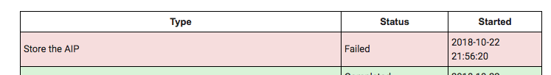
Archivematica
~5 hours to process a valid bag of FFV1/MKV in Archivematica
Research into ‘store AIP’ failures
Working with Artefactual to create a separate archivematica (v 1.8) pipeline exclusively for processing DPX
Notes:
We ran these test files through one our our Archivematica testing pipeline and saw that it took roughly about 5 hours to process a dpx sequence transcoded to ffv1 wrapped in matroska, but we also need to do further research into ‘store AIP’ failures we were getting. We are also working with Artefactual towards creating a separate archivematica pipeline for exclusively processing DPX.

Slide 30
Next steps
More testing including escrow retrieval
Deep analysis of our research results
Develop a methodology for the condition assessment of DPX files
Attending #NTTW3
Starting robust dialogue with colleagues and peers including a convening for a peer forum in November to see and discuss what others in the field are doing
Notes:
Next steps
More testing including escrow retrieval
Analysis of research
Developing methodologies for condition assessment of DPX files
Attending #NTTW3
Starting robust dialogue with colleagues and peers including a convening for a peer forum in November to see and discuss what others in the field are doing

Slide 31
Questions?

